Slide 1


DESIGN AND ANALYSIS OF ALGORITHM
MODULE 1

Slide 2
Algorithm
An algorithm is a finite, ordered sequence of well-defined and unambiguous instructions that, when executed, solves a given problem or performs a computation.
In computer science, an algorithm represents the logical solution to a problem, independent of any programming language or hardware. It specifies what steps to perform and in what order, not how they are coded.
Example :Find the maximum of two numbers
Algorithm:
Read two numbers A and B
If A > B, print A
Else, print B

Slide 3
Characteristics of an Algorithm
For a procedure to be considered a valid algorithm, it must satisfy the following characteristics:
1. Input
An algorithm must accept zero or more inputs.
Inputs are the data supplied to the algorithm before execution.
2. Output
An algorithm must produce at least one output.
Output is the result of processing the input.
3. Definiteness
Each step must be clear, precise, and unambiguous.
No instruction should have multiple interpretations.

Slide 4
4. Finiteness
The algorithm must terminate after a finite number of steps.
Infinite loops violate this property.
Ensures that the problem is solvable in practice.
5. Effectiveness
Each step must be basic and feasible, executable in finite time.
Instructions should not be abstract or impractical.
Example: “Compare two numbers” is effective; “Predict the future” is not.
6.Independent
An algorithm should have step-by-step directions, which should be independent of any programming code.
It could run on any of the programming languages.

Slide 5
Steps Involved in Designing an Algorithm
1. Problem Definition
Clearly understand and define the problem to be solved.
Identify:
  Objectives of the problem
  Constraints and assumptions
Remove ambiguity and specify the exact requirements.
2. Identification of Inputs and Outputs
Determine the inputs required by the algorithm.
Specify the outputs that the algorithm should produce.
Helps in setting clear boundaries for the solution.

Slide 6
3. Problem Decomposition
Break the main problem into smaller subproblems.
Simplifies complex problems and supports modular design.
Each subproblem can be solved independently.
4. Selection of Appropriate Data Structures
Choose suitable data structures for storing and processing data efficiently.
Examples:
  Arrays for indexed data
  Stacks and queues for sequential processing
  Trees and graphs for hierarchical or network-based problems

Slide 7
5. Choice of Algorithm Design Technique
Select a suitable strategy based on the problem type, such as:
  Brute Force
  Divide and Conquer
  Greedy Method
  Dynamic Programming
  Backtracking
  Branch and Bound
6. Algorithm Development
Develop a step-by-step logical solution.
Ensure that each step is: Clear, Unambiguous and Finite
7. Algorithm Representation
Represent the algorithm using:
  Pseudocode
  Natural language
  Flowcharts
Makes the algorithm easy to understand, review, and communicate.

Slide 8
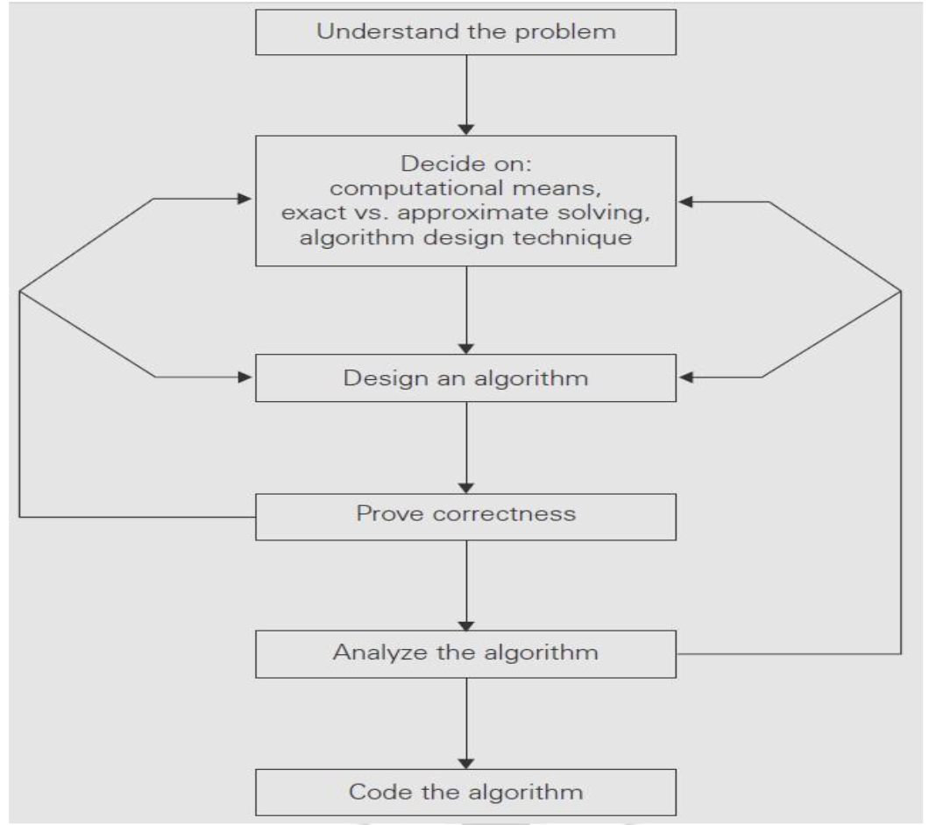
Algorithm design and analysis process

Slide 9
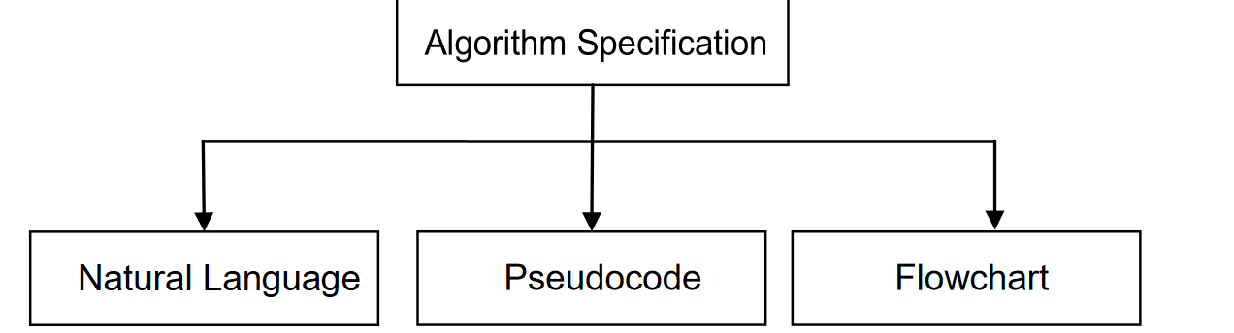
Methods of Specifying an Algorithm
There are three ways to specify an algorithm.
Q: Write an algorithm to perform addition of two numbers.

Slide 10
Add two numbers entered by the user
Step 1: Start
Step 2: Declare variables num1, num2 and sum.
Step 3: Read values num1 and num2.
Step 4: Add num1 and num2 and assign the result to sum.
sum←num1+num2
Step 5: Display sum
Step 6: Stop

Slide 11
Find the largest number among three numbers
Step 1: Start
Step 2: Declare variables a,b and c.
Step 3: Read variables a,b and c.
Step 4: If a > b
If a > c
Display a is the largest number.
Else
If b > c
Display b is the largest number.
Else
Display c is the greatest number.
Step 5: Stop

Slide 12
Find the factorial of a number
Step 1: Start
Step 2: Declare variables n, factorial and i.
Step 3: Initialize variables
factorial ← 1
i ← 1
Step 4: Read value of n
Step 5: Repeat the steps until i = n
5.1: factorial ← factorial*i
5.2: i ← i+1
Step 6: Display factorial
Step 7: Stop

Slide 13
Important Problem Types in Algorithmic Problem Solving
1. Searching Problems
Objective:
Determine whether a given element exists in a dataset and, if so, find its position.
Examples:
Linear search
Binary search
Applications:
Database queries
File searching
Information retrieval systems

Slide 14
2. Sorting Problems
Objective:
Arrange data elements in a specific order (ascending or descending).
Examples:
Bubble sort
Merge sort
Quick sort
Heap sort
Applications:
Data organization
Efficient searching
Ranking systems

Slide 15
3. Optimization Problems
Objective:
Find the best possible solution from a set of feasible solutions based on an objective function.
Examples:
Shortest path problem
Knapsack problem
Minimum spanning tree
Applications:
Resource allocation
Scheduling

Slide 16
Notion of Algorithmic Efficiency
The notion of algorithmic efficiency refers to how effectively an algorithm utilizes computational resources, primarily time and memory, to solve a problem. An efficient algorithm produces the correct result using minimum possible resources, especially as the input size grows.

Slide 17
Need for Algorithmic Efficiency
Different algorithms can solve the same problem with vastly different performance.
Inefficient algorithms may be impractical for large input sizes.
Efficiency helps in:
  Reducing execution time
  Saving memory
  Improving scalability
Example:
Linear search vs Binary search for large datasets. For large datasets, binary search is significantly faster and more efficient than linear search, provided the data is sorted.

Slide 18
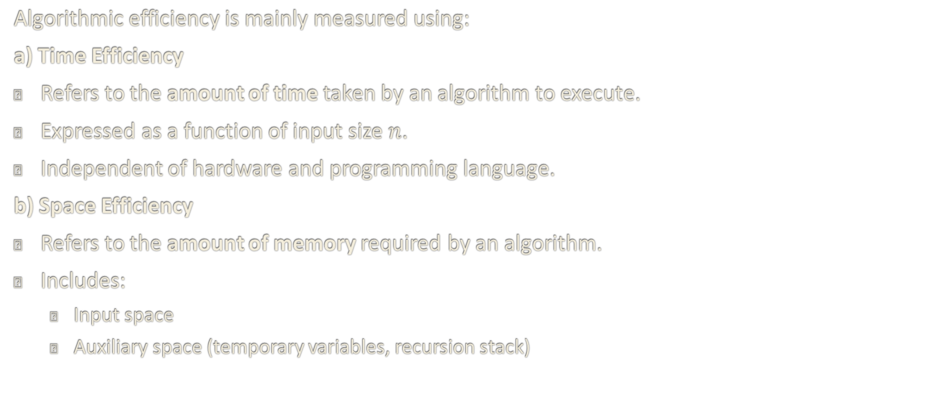
Measures of Algorithmic Efficiency
Algorithmic efficiency is mainly measured using:
a) Time Efficiency
Refers to the amount of time taken by an algorithm to execute.
Expressed as a function of input size $n$.
Independent of hardware and programming language.
b) Space Efficiency
Refers to the amount of memory required by an algorithm.
Includes:
  Input space
  Auxiliary space (temporary variables, recursion stack)

Slide 19
Efficiency is analyzed under three cases:
Best Case
Minimum time or space required.
Occurs under ideal input conditions.
Average Case
Expected efficiency over all possible inputs.
More realistic but harder to compute.
Worst Case
Maximum time or space required.
Most commonly used in analysis for guaranteed performance.

Slide 20
Time Complexity and Space Complexity
Algorithmic efficiency is measured through two main lenses, typically expressed as a mathematical function of the input size n
Time Complexity: Measures the number of elementary operations an algorithm performs. This estimates the "speed" of the algorithm relative to the amount of data it processes.
Simply Time Complexity tells us how much time an algorithm takes as the input size n increases.
We usually express it using Big-O notation.
Space Complexity: Measures the amount of memory (RAM or auxiliary storage) required for execution. Simply Space Complexity tells us how much extra memory an algorithm uses.

Slide 22
Linear Search
Linear search is a sequential searching algorithm where we start from one end and check every element of the list until the desired element is found. It is the simplest searching algorithm.
To implement the Linear Search algorithm ,we need:
An array with values to search through.
A target value to search for.
A loop that goes through the array from start to end.
An if-statement that compares the current value with the target value, and returns the current index if the target value is found.

Slide 23
Example
Consider the array arr[] = {10, 50, 30, 70, 80, 20, 90, 40} and key = 30

Slide 24
Algorithm
The algorithm is simple and does not require the data to be sorted.
The steps involved are:
Start from the first element (index 0) of the array or list.
Compare the current element with the target value you are searching for.
If a match is found, the search is successful, and the index or position of the element is returned.
If the values do not match, move to the next element in the sequence and repeat the comparison process.
If the end of the list is reached and no match was found, the search is unsuccessful, typically indicated by returning a special value like -1

Slide 25
Advantages and Disadvantages of
Linear Search Algorithm:
Advantages of Linear Search Algorithm:
Linear search can be used irrespective of whether the array is sorted or not. It can be used on arrays of any data type.
Does not require any additional memory.
It is a well-suited algorithm for small datasets.
Disadvantages of Linear Search Algorithm:
Linear search has a time complexity of O(N), which in turn makes it slow for large datasets.
Not suitable for large arrays.

Slide 26
Applications of Linear Search Algorithm:
Unsorted Lists: When we have an unsorted array or list, linear search is most commonly used to find any element in the collection.
Small Data Sets: Linear Search is preferred over binary search when we have small data sets with
Searching Linked Lists: In linked list implementations, linear search is commonly used to find elements within the list. Each node is checked sequentially until the desired element is found.
Simple Implementation: Linear Search is much easier to understand and implement as compared to Binary Search or Ternary Search.

Slide 27
Time and Space Complexity of Linear Search Algorithm:
Time Complexity:
Best Case: In the best case, the key might be present at the first index. So the best case complexity is O(1)
Worst Case: In the worst case, the key might be present at the last index i.e., opposite to the end from which the search has started in the list. So the worst-case complexity is O(N) where N is the size of the list.
Average Case: O(N)
Space complexity: O(1) as except for the variable to iterate through the list, no other variable is used.

Slide 28
Binary Search
Binary Search is a searching algorithm for finding an element's position in a sorted array.
In this approach, the element is always searched in the middle of a portion of an array.
Binary search can be implemented only on a sorted list of items. If the elements are not sorted already, we need to sort them first.
It operates on the principle of "divide and conquer" and has a time complexity of O(log N), making it significantly faster than a linear search for large datasets.

Slide 29
How Binary Search Works
Initialization: Set the low pointer to the first element's index (0) and the high pointer to the last element's index (length - 1) of the sorted array.
Find the Middle: Calculate the middle index: mid = (low + high) / 2 (integer division).
Compare: Compare the value at the middle index with the target value:
  If they are equal, the target is found, and its position is returned.
  If the target value is less than the middle element, the target must be in the lower half of the array. The algorithm discards the upper half by setting the high pointer to mid - 1.
  If the target value is greater than the middle element, the target must be in the upper half of the array. The algorithm discards the lower half by setting the low pointer to mid + 1.
Repeat: Repeat steps 2 and 3 until the target is found or the low pointer exceeds the high pointer, at which point the search space is empty and the target is not in the array.

Slide 30
Characteristics
The primary characteristic is that the input data structure (typically an array) must be sorted in a specific order (ascending or descending) for the algorithm to work correctly. Applying it to unsorted data produces unpredictable results.
Divide and Conquer: The algorithm repeatedly divides the search space in half during each iteration.
Logarithmic Time Complexity (O(log n)):Worst-case and Average-case: The time complexity is O(log n), meaning the number of comparisons grows logarithmically with the number of elements n in the array.
  For example, searching an array of over a million elements requires at most 20 comparisons. Best-case: In the best case, the target element is the middle element of the array and is found in a single comparison (O(1) time).
Efficient for Large Datasets: The logarithmic time complexity makes binary search significantly faster than linear search for large collections of data.
Random Access Requirement: The algorithm needs constant-time (O(1)) access to any element in the dataset (specifically the middle element), which is why it works well with arrays but is inefficient for data structures like linked lists.
Space Complexity: The iterative implementation of binary search has a constant space complexity of O(1) as it only uses a few variables to track indices.

Slide 31
Sorting
A sorting algorithm is used to arrange elements of an array/list in a specific order.
There are various sorting algorithms that can be used to complete this operation.
The efficiency of any sorting algorithm is determined by the time complexity and space complexity of the algorithm.

Slide 32
Bubble Sort
Bubble sort is a sorting algorithm that compares two adjacent elements and swaps them until they are in the intended order.
Working of Bubble Sort
  Start with the first element.
  Compare the current element with the next element.
  If the current element is greater than the next element, then swap both the elements. If not, move to the next element.
  Repeat steps 1 – 3 until we get the sorted list.

Slide 33
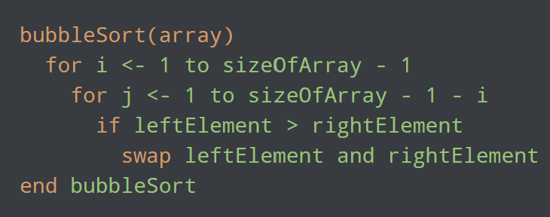

Slide 34
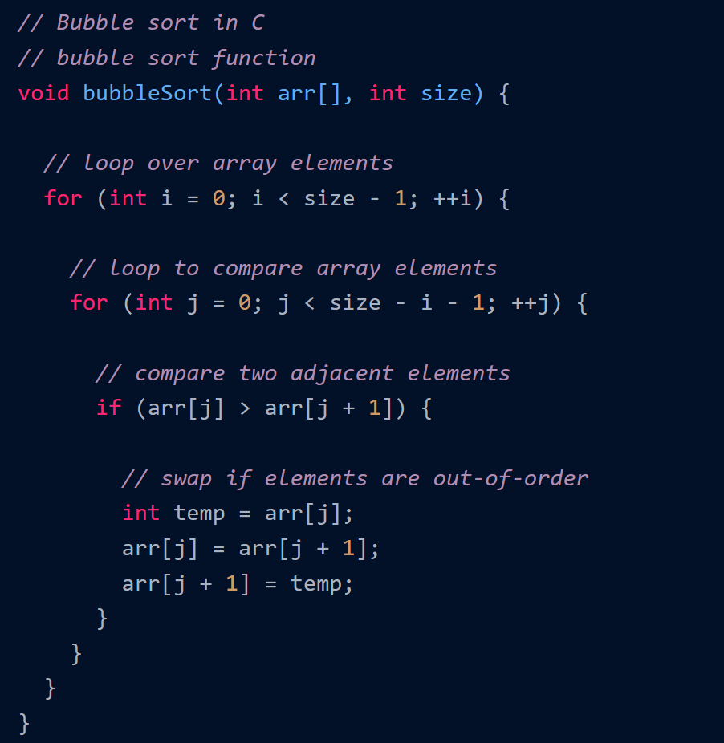
C Program

Slide 35
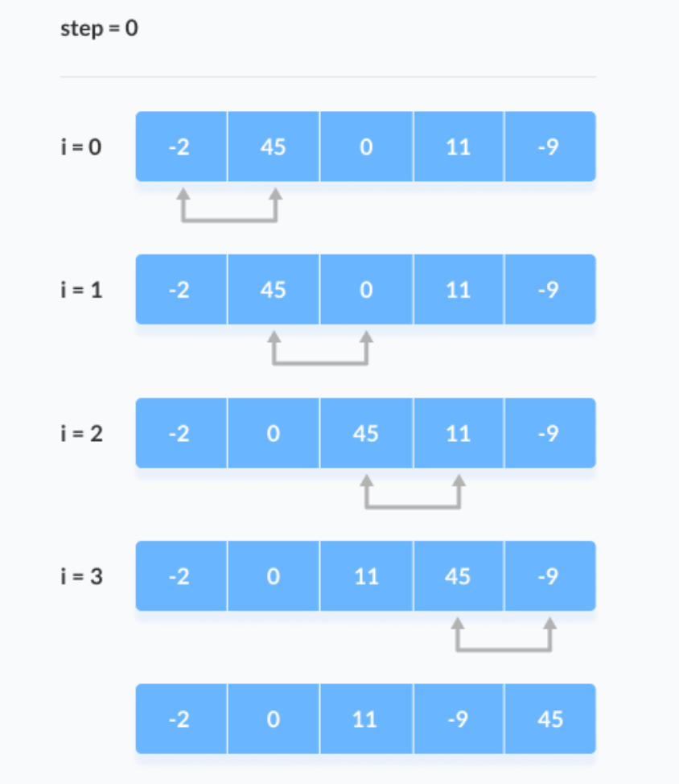
Example

Slide 36
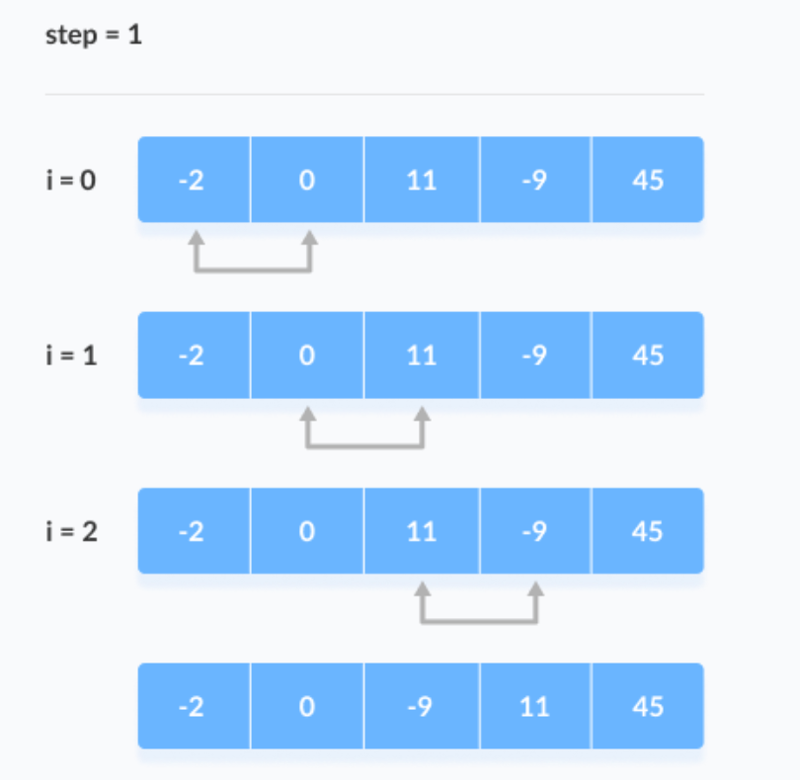

Slide 37
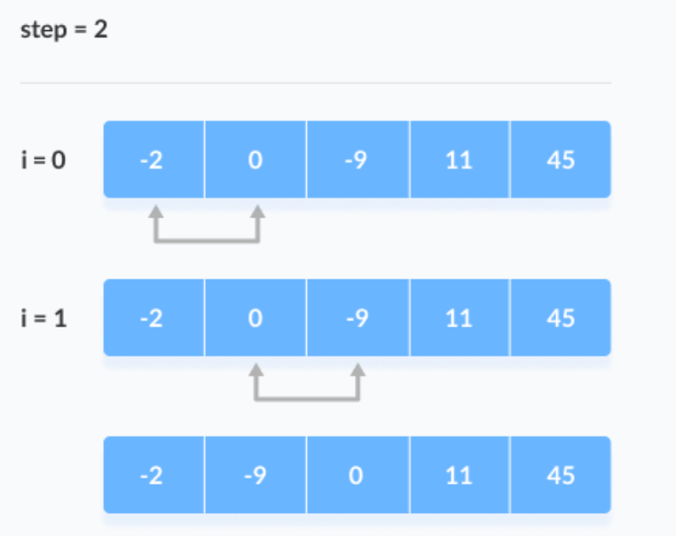

Slide 38
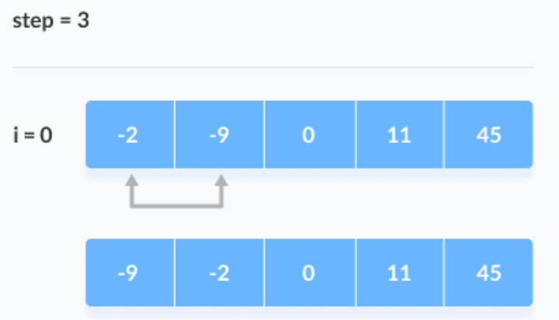

Slide 39
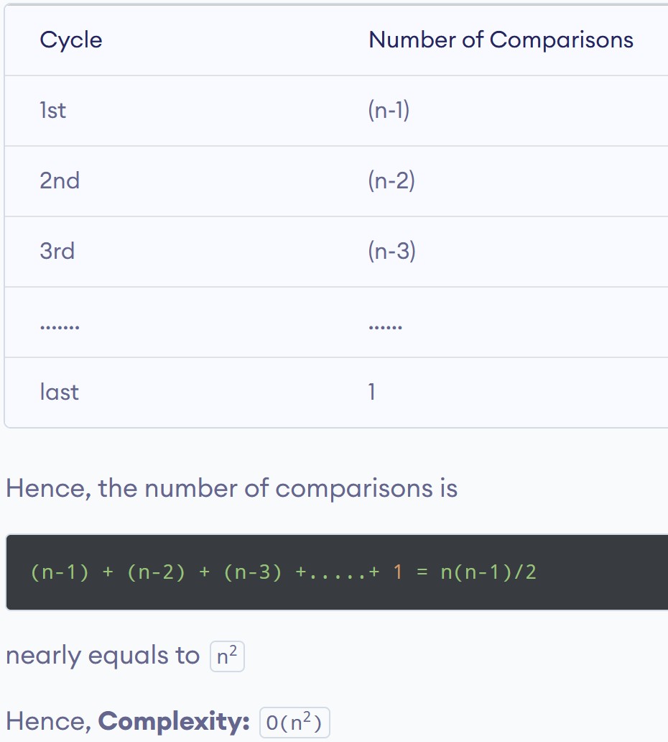
Bubble Sort Complexity
1. Time Complexity

Slide 40
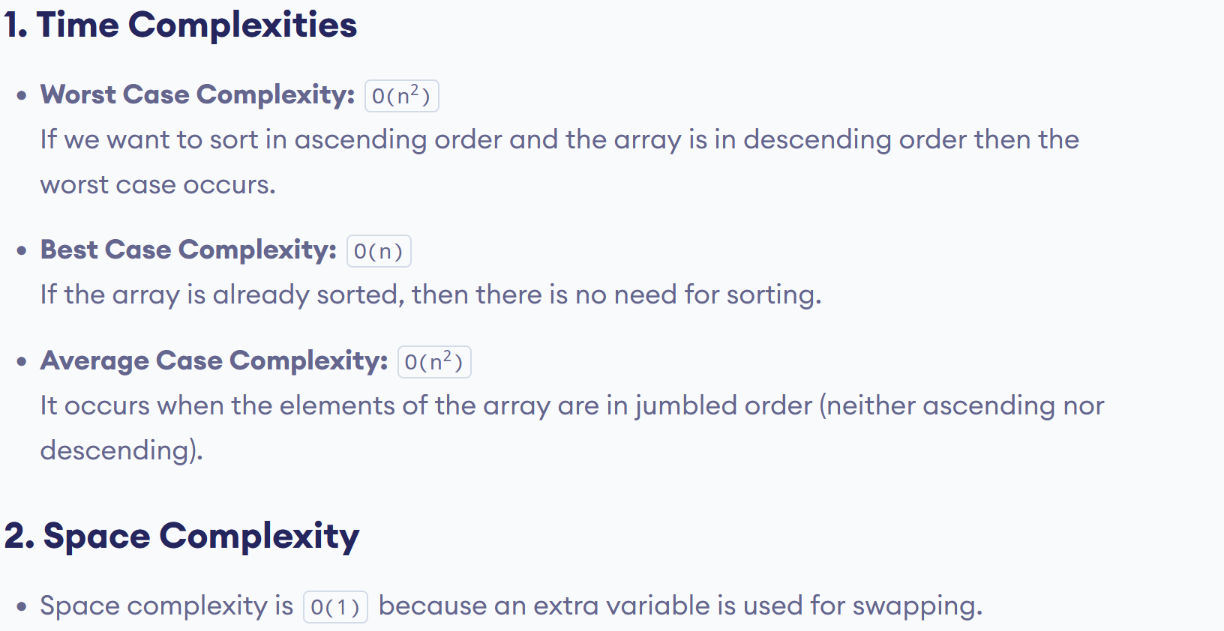

Slide 41
Insertion Sort Algorithm
Insertion sort is a sorting algorithm that places an unsorted element at its suitable place in each iteration.
Insertion sort works similarly as we sort cards in our hand in a card game.
We assume that the first card is already sorted then, we select an unsorted card. If the unsorted card is greater than the card in hand, it is placed on the right otherwise, to the left. In the same way, other unsorted cards are taken and put in their right place.
In this sorting technique, we assume that the first number in the array is in the sorted section and the rest of all the other numbers in the array are in the unordered section. Now we will pick each number from the unsorted section and insert that number at a proper position in the sorted section by shifting the numbers towards the right.

Slide 42
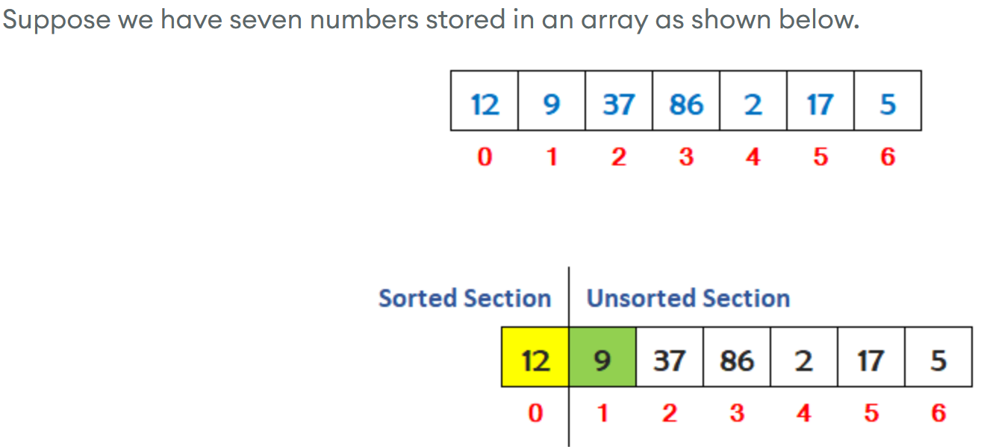
Insertion Sort Example

Slide 43
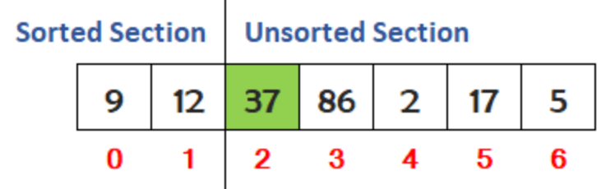
First, select the number 9 from the unsorted section of the array and find its proper position in the sorted section of the array. The proper position of 9 is at index 0. So, we have to shift the numbers from the sorted section of the array towards the right to insert 9 at it proper position.
Now, select the number 37 from the unsorted section of the array and find its proper position in the sorted section of the array. We can see that the number is already at it proper position. So leave it.

Slide 44
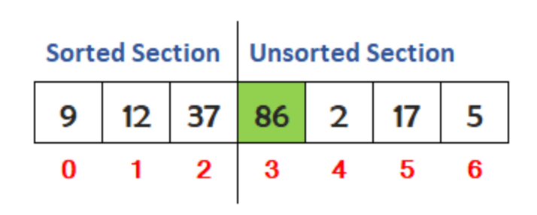
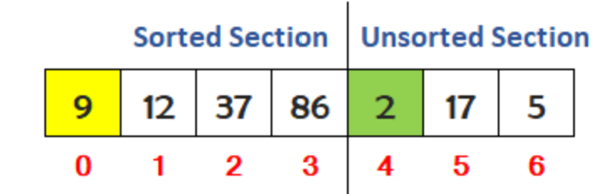
Now, select the number 86 from the unsorted section of the array and find its proper position in the sorted section of the array. We can see that the number is already at it proper position. So leave it.
Now, select the number 2 from the unsorted section of the array and find its proper position in the sorted section of the array. The proper position of 2 is at index 0. So, we have to shift the numbers from the sorted section of the array towards the right to insert 2 at it proper position.

Slide 45
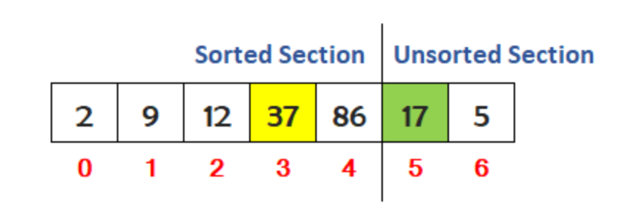
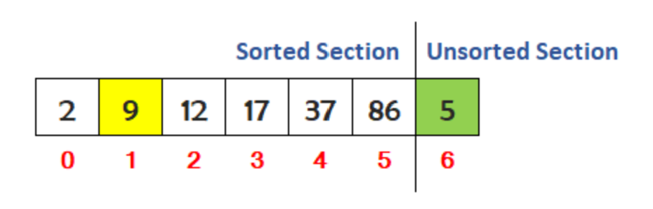
Now, select the number 17 from the unsorted section of the array and find its proper position in the sorted section of the array. The proper position of 17 is at index 3. So, we have to shift the numbers from the sorted section of the array towards the right to insert 17 at it proper position.
Now, select the number 5 from the unsorted section of the array and find its proper position in the sorted section of the array. The proper position of 5 is at index 1. So, we have to shift the numbers from the sorted section of the array towards the right to insert 5 at it proper position.

Slide 46
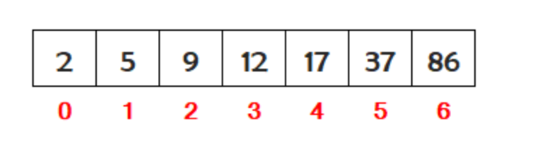

Slide 47
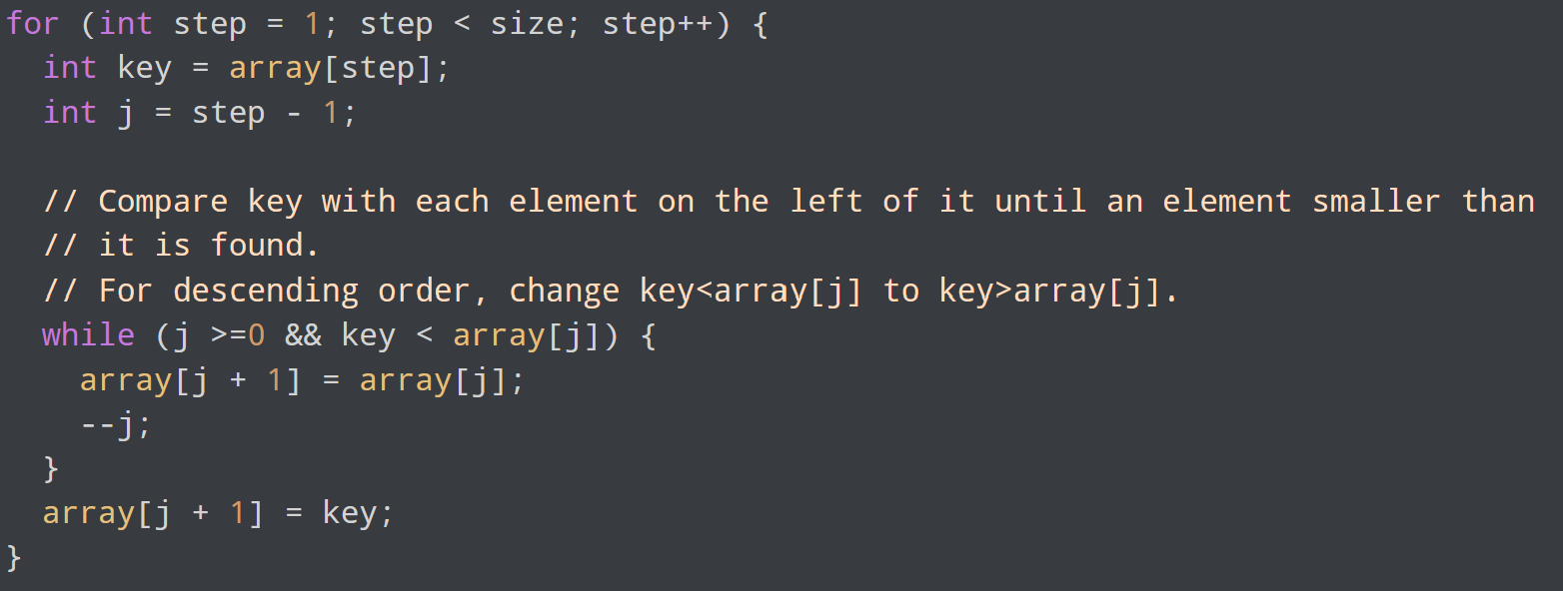

Slide 48
Complexity Analysis of Insertion Sort
Time Complexity
  Best case: O(n), If the list is already sorted, where n is the number of elements in the list.
  Average case: O(n²), If the list is randomly ordered
  Worst case: O(n²), If the list is in reverse order
Space Complexity
  Auxiliary Space: O(1), Insertion sort requires O(1) additional space, making it a space-efficient sorting algorithm.

Slide 49
RAM MODEL
Machine independent algorithm design depends upon a hypothetical computer called Random Access Machine or RAM Model
To find the best algorithm, we measure the run time of an algorithm by counting up number of steps it takes on a given problem instance.
Number of steps an algorithm takes for a given input will decide the run time of algorithm

Slide 50
RAM MODEL of Computation
Each simple operation takes exactly one step
Each memory access takes exactly one step
Loops and subroutines are not considered simple operations instead they are composition of many single step operation.
The time it takes to run through a loop or execute a subprogram depends upon the number of loop iterations or the specific nature of subprogram.

Slide 51
Frequency Count
By expressing the running time of algorithm as function of input size n f(n) & compare these different function corresponding to running time.
Function is independent of hardware and language

Slide 52
Example
Swap 2numbers
Start
Read 2numbers num1, num2
T=num1
num1=num2
num2=T
Print num1, num2
F(n) =5 O(n) =1
S(n) =3 O(n) =1

Slide 53
Example
F(n) =2n+3, O(n)
Space
A=n
N=1
S=1
i=1
S(n) =n+3, O(n)
Algorithm sum(A, n)
{
S=0
for(i=0;i<n;i++)
{
S=S+A[i]
}
Return s
}
1
N+1
N
1

Slide 54
Example
F(n) =2n^2+2n+1
Function is of order n^2
Space
A=n^2
B=n^2
C=n^2
N=1
I=1
J=1
S(n) =3n^2+3
Is of order n^2
Algorithm Add(A, B, n)
for(i=0;i<n;i++)
{
for(j=0;j<n;j++)
{
c[i][j]=a[i][j]+b[i][j]
}
}
N+1
N*N+1
N*N

Slide 55
Types of functions
O(1) –constant
O(logn) –logarithmic
O(n) –linear
O(n^2) –quadratic
O(n^3) –cubic
O(2^n) –Exponential
1<logn<√n<n<nlogn<n^2<n^3<2^n<n^n

Slide 56
Asymptotic analysis
Asymptotic Notations - allow us to analyze an algorithm's running time by identifying its behavior as the input size for the algorithm increases. I.e variation of time with input size is calculated.
This is also known as an algorithm's growth rate.
Efficiency of an algorithm:
  An algorithm with less running time and needs less memory is considered to be efficient.
Analysis of algorithm aimed to find the running time of an algorithm.

Slide 57
Asymptotic analysis
The exact analysis gives the exact polynomial for that relates the input size with the running time, whereas the approximate analysis gives the power of input size on which the running time depends.
Example: the exact running time of an algorithm may be 3n^2+2n+3. The appx running time would be f(n^2).
The highest powers of n is what matters while calculating the appx running time of an algorithm.

Slide 58
Asymptotic analysis
Asymptotic analysis is the theory of approximation .
It can be very effective for algorithm analysis where finding the exact time complexity is difficult by the process of counting.
Using asymptotic analysis, we can very well conclude the best case, average case, and worst-case scenario of an algorithm.
Asymptotic analysis is input bound i.e., if there's no input to the algorithm, it is concluded to work in a constant time. Other than the "input" all other factors are considered constant.
Asymptotic analysis refers to computing the running time of any operation in mathematical units of computation.

Slide 59
Why Worst Case Analysis?
Worst case running time :
It is the longest running time for any input of size n.
We usually concentrate on finding only the worst-case running time, that is, the longest running time for any input of size n, because of the following reasons:
  The worst-case running time of an algorithm gives an upper bound on the running time for any input. Knowing it provides a guarantee that the algorithm will never take any longer.
  For some algorithms, the worst case occurs fairly often. For example, in searching a database for a particular piece of information, the searching algorithm’s worst case will often occur when the information is not present in the database.
The “average case” is often roughly as bad as the worst case.

Slide 60
Asymptotic Notations
O notation: asymptotic “less than”:
Ω notation: asymptotic “greater than”:
Θ notation: asymptotic “equality”:

Slide 61
O-notation
We use O-notation to give an upper bound on a function , to within a constant factor.
Definition:
Given functions f(n) and g(n), we say that f(n) is O(g(n)) if there are positive constants c and n₀ such that
f(n) ≤ c.g(n) for n ≥ n₀
Explanation:
We Write f(n) = O(g(n)) if there are positive constants n₀ and c such that at and to the right of n₀, the value of f(n) always lies on or below c g(n).

Slide 62
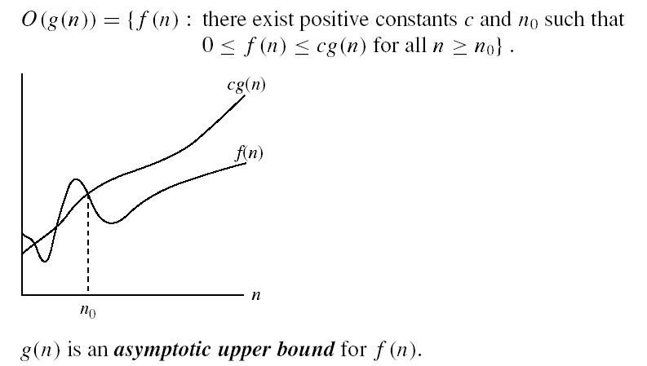
Asymptotic Notations
O-notation

Slide 63
Example
is O(n).

Slide 64
Big-Oh Rules
If is f(n) a polynomial of degree d, then f(n) is O(n^{d}), i.e.,
  Drop lower-order terms
  Drop constant factors
Use the smallest possible class of functions
  Say “2n is O(n)” instead of “2n is O(n²)”
Use the simplest expression of the class
  Say “3n + 5 is O(n)” instead of “3n + 5 is O(3n)”

Slide 65
Problem
f(n)=7n-2
  7n-2 is O(n)
  need c > 0 and n₀ ≥ 1 such that 7n-2 ≤ c•n for n ≥ n₀
  this is true for c = 7 and n₀ = 1
f(n)=7n+2

Slide 66
Problem
f(n) = 3n+2

Slide 67
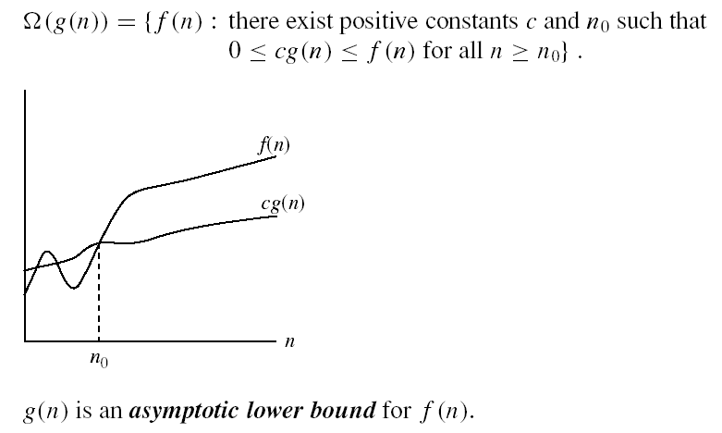
Asymptotic Notations
Ω - notation
ie, f(n) is Ω(g(n)) if there is a constant c > 0 and an integer constant n₀ ≥ 1 such that
f(n) ≥ c•g(n) for n ≥ n₀

Slide 68
Problem
5n² is Ω(n²)
f(n) is Ω(g(n)) if there is a constant c > 0 and an integer constant n₀ ≥ 1 such that f(n) ≥ c•g(n) for n ≥ n₀

Slide 69
Example
f(n) = 3n+2

Slide 70
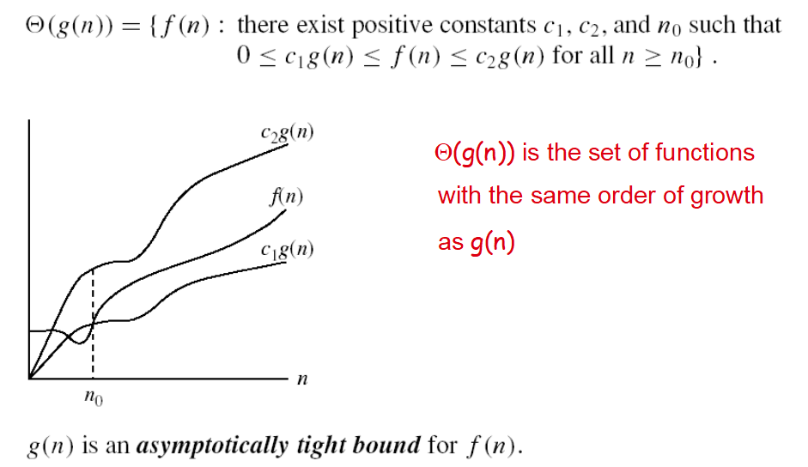
Asymptotic Notations
Θ-notation

Slide 71
Example
f(n) = 3n+2

Slide 72
Time Complexity Analysis of Recursive algorithms
Recurrence: an equation that describes a function in terms of its value on smaller functions
Many algorithms are recursive in nature.
When we analyze them, we get a recurrence relation for time complexity.
We get running time on an input of size n as a function of n and the running time on inputs of smaller sizes.
  For example in Merge Sort, to sort a given array, we divide it in two halves and recursively repeat the process for the two halves. Finally we merge the results.
  Time complexity of Merge Sort can be written as T(n) = 2T(n/2) + cn.

Slide 73
Solving Recurrence Equations
There are three ways of solving recurrences running time:
Substitution method.
Recursion tree method.
Masters theorem.

Slide 74
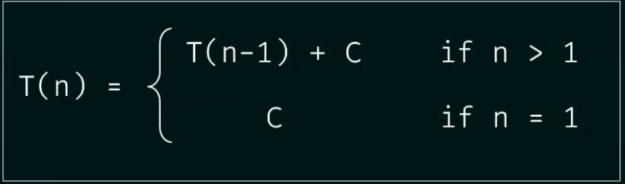
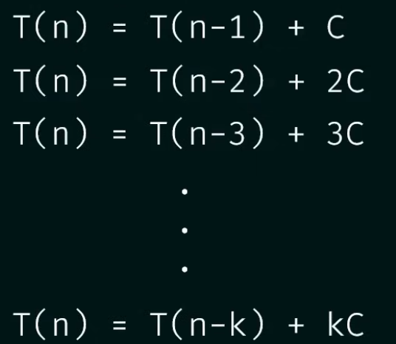
Substitution Method Problem 1

Slide 75
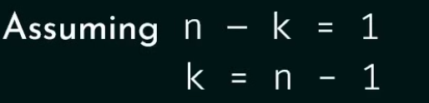





Slide 76
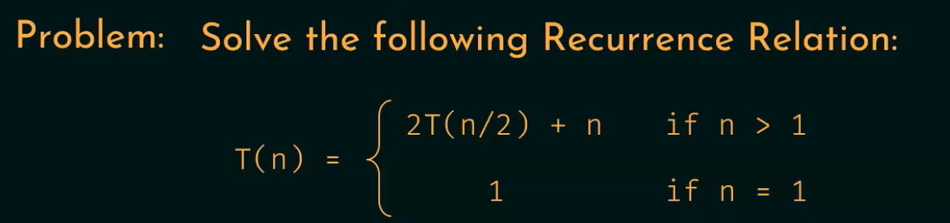
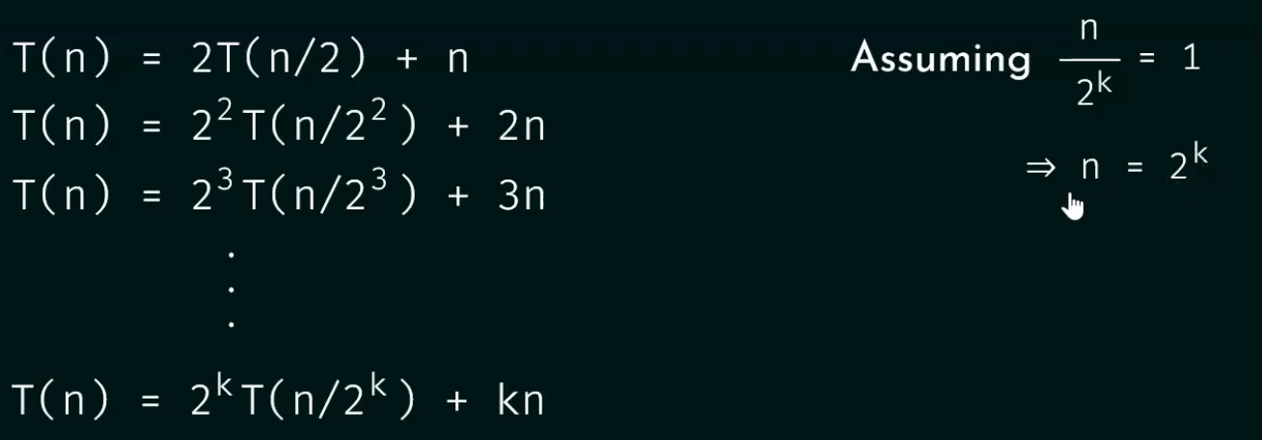
Substitution Method Problem 2

Slide 77
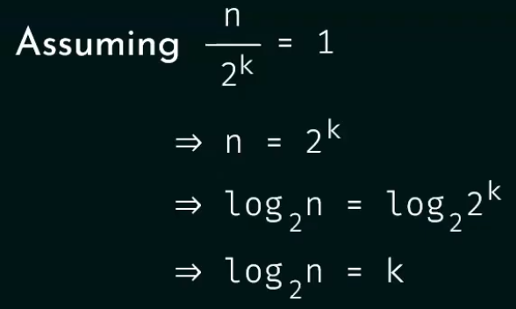






Slide 78
The master method for solving recurrences
Master’s theorem is one of the many methods that are applied to calculate time complexities of algorithms. In analysis, time complexities are calculated to find out the best optimal logic of an algorithm. Master’s theorem is applied on recurrence relations.
Master’s theorem can is applied on decreasing and dividing recurring functions.

Slide 79
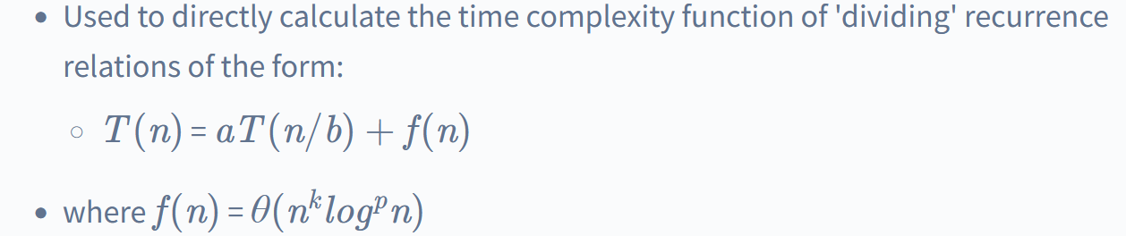
Master’s Theorem for Dividing Functions

Slide 80
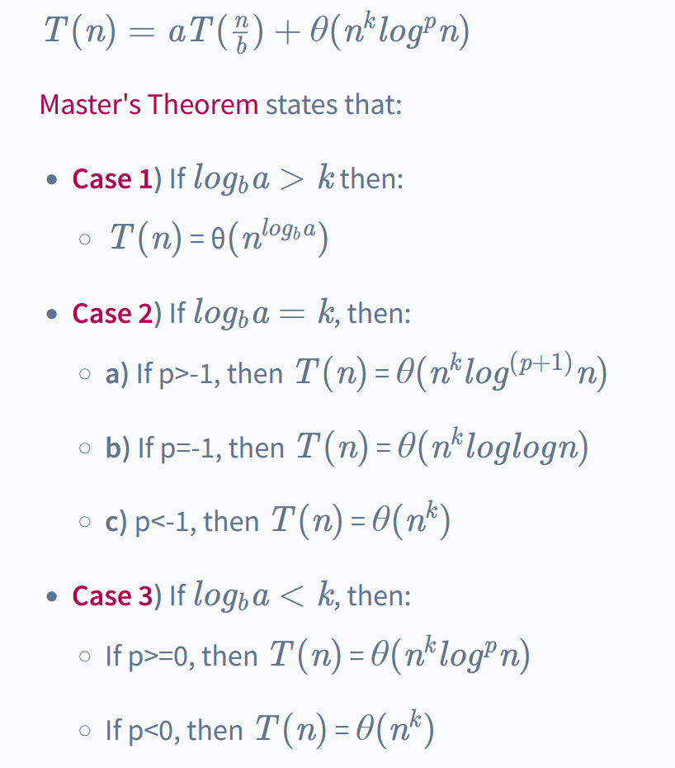
Master’s Theorem for Dividing Functions

Slide 82
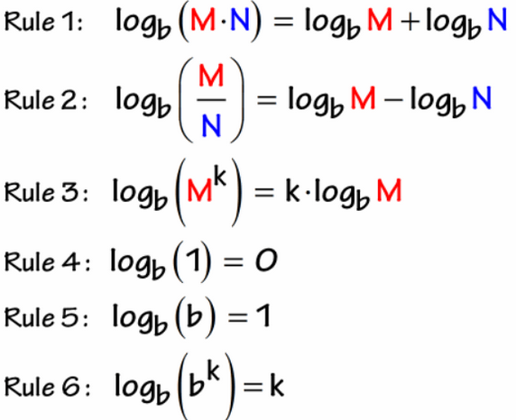

Slide 83
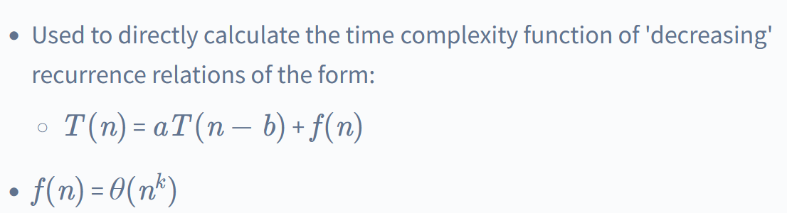
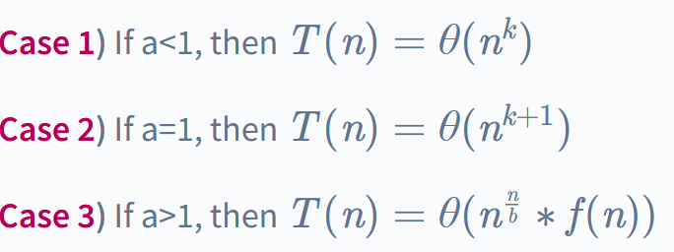
Master's Theorem for Decreasing Functions

